Slide 1
Star Life Cycle

Slide 3
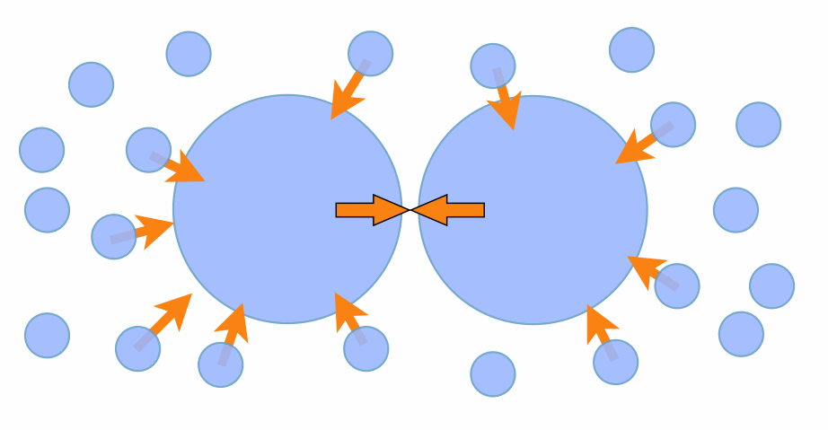
It all starts with Gravity
Gases (ex: ____) and Dust (ex:_____) start to clump together.
Gravity: N__________ law: All particles exert a . on all other objects.

Slide 4
It all starts with Gravity
Gases (ex: H) and Dust (ex: Silicates) start to clump together.
Gravity: Newton’s law: All particles exert a force on all other objects.

Slide 5
Nebula: A Star Nursery
N : cloud of gas and d held together by g .
Smaller pieces may break off to form s , if too small may form p .
Notes:
A nebula is a cloud of gas (hydrogen) and dust in space. Nebulae are the birthplaces of stars. There are different types of nebula. An Emission Nebula e.g. such as Orion nebula, glows brightly because the gas in it is energised by the stars that have already formed within it. In a Reflection Nebula, starlight reflects on the grains of dust in a nebula. The nebula surrounding the Pleiades Cluster is typical of a reflection nebula. Dark Nebula also exist. These are dense clouds of molecular hydrogen which partially or completely absorb the light from stars behind them e.g. the Horsehead Nebula in Orion.

Slide 6
Nebula: A Star Nursery
Nebula: cloud of gas and dust held together by gravity.
Smaller pieces may break off to form stars , if too small may form planets.
Notes:
A nebula is a cloud of gas (hydrogen) and dust in space. Nebulae are the birthplaces of stars. There are different types of nebula. An Emission Nebula e.g. such as Orion nebula, glows brightly because the gas in it is energised by the stars that have already formed within it. In a Reflection Nebula, starlight reflects on the grains of dust in a nebula. The nebula surrounding the Pleiades Cluster is typical of a reflection nebula. Dark Nebula also exist. These are dense clouds of molecular hydrogen which partially or completely absorb the light from stars behind them e.g. the Horsehead Nebula in Orion.

Slide 7
Reflecting vs Dark Nebula
Notes:
Left: In a Reflection Nebula, starlight reflects on the grains of dust in a nebula. The nebula surrounding the Pleiades Cluster is typical of a reflection nebula
Right: Dark Nebula Dark. These are dense clouds of molecular hydrogen which partially or completely absorb the light from stars behind them e.g. the Horsehead Nebula in Orion

Slide 8
Formation of a Protostar
Matter C due to g .
The temperature begins to I .
Cloud rotates and flattens into a d .
Notes:
Image of protostar object called Herbig-Haro 46/47. It is taken by Spitzer Space Telescope using near-infrared light to pierce through the dark cloud.

Slide 9
Formation of a Protostar
Matter Condenses due to gravity.
The temperature begins to increase.
Cloud rotates and flattens into a disk.

Slide 10
Protostar
P star: Contractions in the core due to g f .
Notes:
A protostar is a large mass that forms by contraction out of the gas of a giant molecular cloud in the interstellar medium. The protostellar phases is an early stage in the process of star formation. NASA photo of New stars are born when a cloud of dust and gas in interstellar space collapses under its own gravity

Slide 11
Protostar
Protostar: Contractions in the core due to gravitational forces.
Notes:
A protostar is a large mass that forms by contraction out of the gas of a giant molecular cloud in the interstellar medium. The protostellar phases is an early stage in the process of star formation. NASA photo of New stars are born when a cloud of dust and gas in interstellar space collapses under its own gravity

Slide 12
Main sequence stars
______ is fused to form _____.
The star is “burning” ______, this is referred to as “nuclear burning”.
Notes:
A star is a luminous globe of gas producing its own heat and light by nuclear reactions (nuclear fusion). They are born from nebulae and consist mostly of hydrogen and helium gas. Surface temperatures range from 2000�C to above 30,000�C, and the corresponding colours from red to blue-white. The brightest stars have masses 100 times that of the Sun and emit as much light as millions of Suns. They live for less than a million years before exploding as supernovae. The faintest stars are the red dwarfs, less than one-thousandth the brightness of the Sun.The smallest mass possible for a star is about 8% that of the Sun (80 times the mass of the planet Jupiter), otherwise nuclear reactions do not take place. Objects with less than critical mass shine only dimly and are termed brown dwarfs or a large planet. Towards the end of its life, a star like the Sun swells up into a red giant, before losing its outer layers as a Planetary Nebula and finally shrinking to become a white dwarf.

Slide 13
Main sequence stars
__H_ is fused to form __He__.
The star is “burning” _hydrogen_, this is referred to as “nuclear burning”.

Slide 14
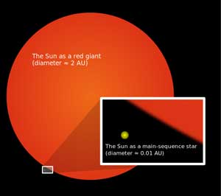
Entering into old age
H _ runs out in core.
Core e and stars g to find more hydrogen in the s , until all the h is gone.
Notes:
When a star has used all the hydrogen in its core, nuclear reactions cease. Deprived of the energy production needed to support it, the core begins to collapse into itself and becomes much hotter. Hydrogen is still available outside the core, so hydrogen fusion continues in a shell surrounding the core. The increasingly hot core also pushes the outer layers of the star outward, causing them to expand and cool, and transforming the star into a red giant

Slide 15
Entering into old age
Hydrogen_ runs out in core; core __expands_ and stars __grows to find more hydrogen in the ___shells_, until all the ___hydrogen__ is gone.
Notes:
When a star has used all the hydrogen in its core, nuclear reactions cease. Deprived of the energy production needed to support it, the core begins to collapse into itself and becomes much hotter. Hydrogen is still available outside the core, so hydrogen fusion continues in a shell surrounding the core. The increasingly hot core also pushes the outer layers of the star outward, causing them to expand and cool, and transforming the star into a red giant

Slide 16
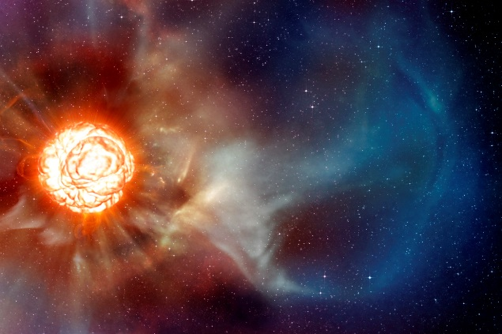
Red Giants
R G : star now “burns” h in the core and in the shell.
The star pulses a few times during this time.
Notes:
The future demise of our Sun is being played out 550 light years away by a star in the constellation Cygnus, the Swan, as a death scene that is drawn-out but spectacular. Chi Cygnus, a red giant much like the one our Sun will become, sits in the neck of the Swan and seems to throb as it expires, as if with a cosmic pulse. New images of the surface of the star captured the details of these death throes in beautiful relief and may change the understanding of how stars like ours end their lives.
.The process of becoming a red giant is long and painful for the surrounding celestial bodies. For example, when our sun begins the death process in about 1.1 billion years, it will start to grow hotter as it burns more hydrogen. The result is that the sun’s output will increase, and in 1.1 billion years, that output will be 10 percent greater than it is right now. The future demise of our Sun is being played out 550 light years away by a star in the constellation Cygnus, the Swan, as a death scene that is drawn-out but spectacular. Chi Cygnus, a red giant much like the one our Sun will become, sits in the neck of the Swan and seems to throb as it expires, as if with a cosmic pulse. New images of the surface of the star captured the details of these death throes in beautiful relief and may change the understanding of how stars like ours end their lives.

Slide 17
Red Giants
Red Giants: star now “burns” helium in the core and in the shell.
The star pulses a few times during this time.
Notes:
The future demise of our Sun is being played out 550 light years away by a star in the constellation Cygnus, the Swan, as a death scene that is drawn-out but spectacular. Chi Cygnus, a red giant much like the one our Sun will become, sits in the neck of the Swan and seems to throb as it expires, as if with a cosmic pulse. New images of the surface of the star captured the details of these death throes in beautiful relief and may change the understanding of how stars like ours end their lives.
.The process of becoming a red giant is long and painful for the surrounding celestial bodies. For example, when our sun begins the death process in about 1.1 billion years, it will start to grow hotter as it burns more hydrogen. The result is that the sun’s output will increase, and in 1.1 billion years, that output will be 10 percent greater than it is right now. The future demise of our Sun is being played out 550 light years away by a star in the constellation Cygnus, the Swan, as a death scene that is drawn-out but spectacular. Chi Cygnus, a red giant much like the one our Sun will become, sits in the neck of the Swan and seems to throb as it expires, as if with a cosmic pulse. New images of the surface of the star captured the details of these death throes in beautiful relief and may change the understanding of how stars like ours end their lives.

Slide 18
Red Giants fuse elements . . .
R G runs out as helium and fuses into C .
When the helium is gone, it expands more.

Slide 19
Red Giants fuse elements . . .
Red Giants runs out as helium and fuses into Carbon.
When the helium is gone, it expands more.

Slide 20
Old Age
C runs out as it is fuses into h e like , , , . , and . Iron is important because…

Slide 21
Old Age
Carbon runs out as carbon is fuses into heavier elements like O, Ne, Mg, Si, and Fe. Iron is important because…

Slide 22
Death of a Star
Depending on its __ __ the star will die in a variety of ways.

Slide 23
Death of a Star
Depending on its size the star will die in a variety of ways.

Slide 24
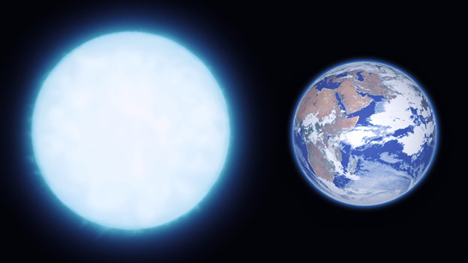
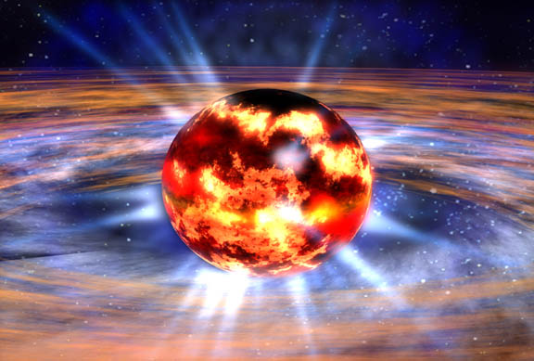
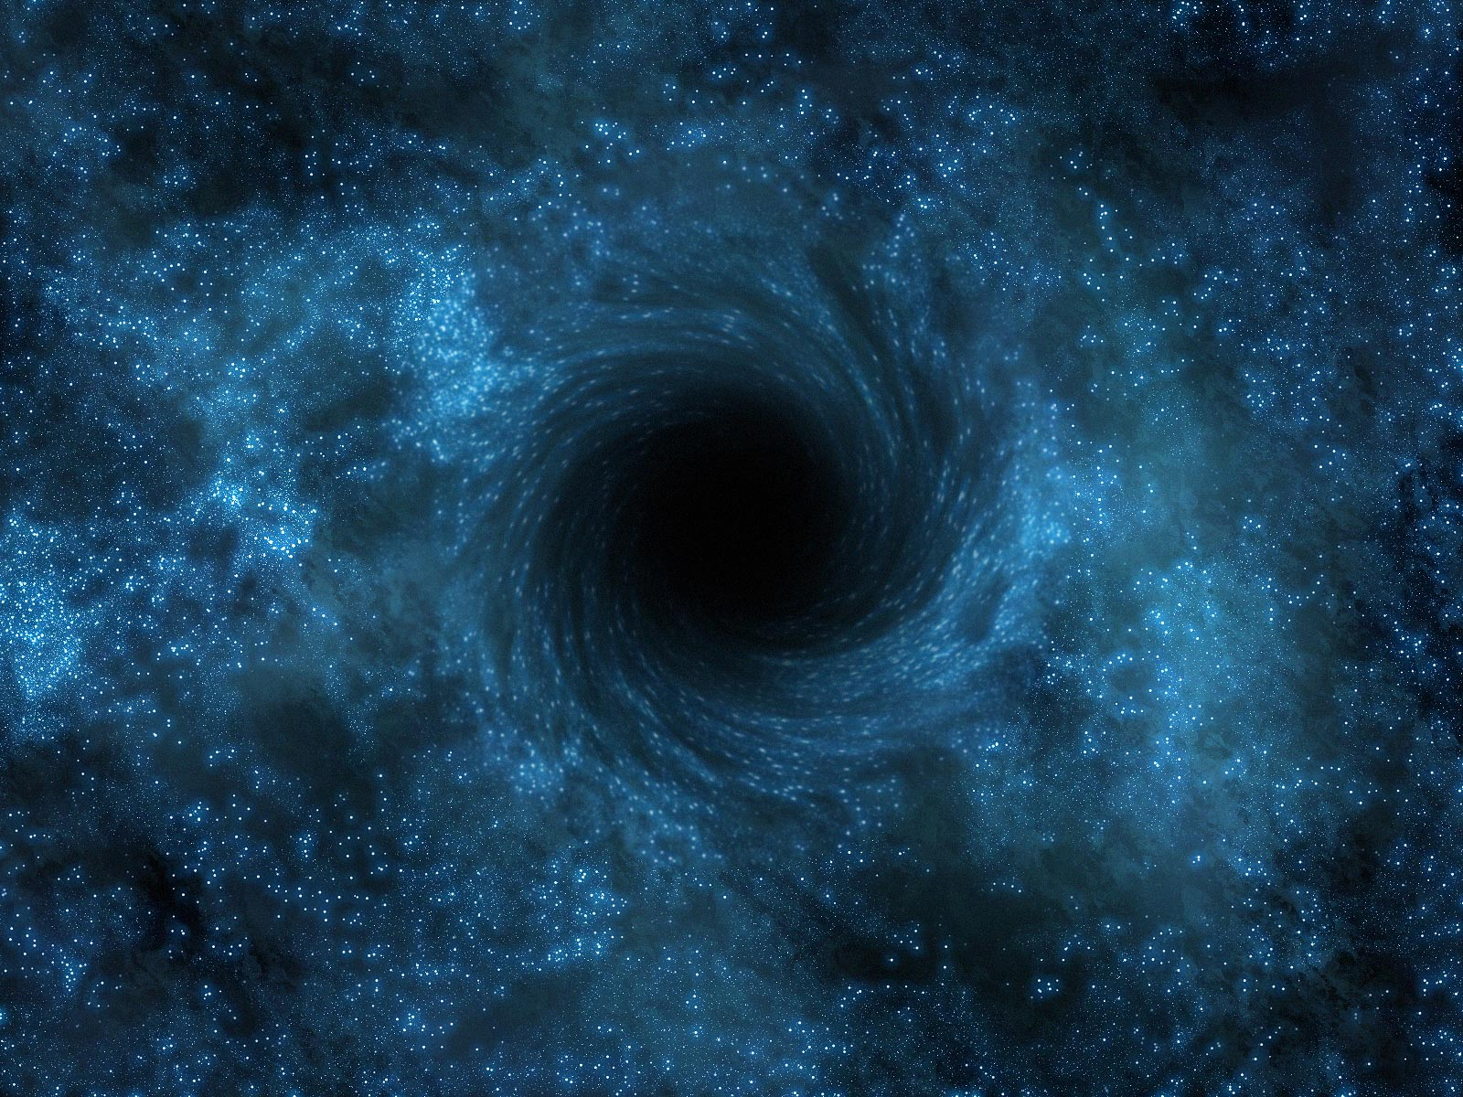
Death, three ways...
W Dwarf Star
N star or P .
B H .

Slide 25
Death, three ways...
White Dwarf Star
Neutron star or Pulsar.
Black Hole

Slide 26
White Dwarf Stars
W Dwarf Stars: have a mass of solar masses or less (<8M)
Loose their outer shell by solar w that develop, last for about 100,000 years.
Core of C and O is exposed, being very hot, glows, ionizing the blown off g and d , shows a p nebula around the white dwarf star.

Slide 27
White Dwarf Stars
White Dwarf Stars: have a mass of 8 solar masses or less (<8M)
Loose their outer shell by solar winds that develop, last for about 100,000 years.
Core of Carbon and Oxygen is exposed, being very hot, glows, ionizing the blown off gas and dust, shows a planetary nebula around the white dwarf star.

Slide 28
Supernova
Stars with mass around 8-25 M collapse and explode in a supernova. They are so bright they can be seen in other galaxies.
Notes:
Supernova 1604, also known as Kepler's Supernova, Kepler's Nova or Kepler's Star, was a supernova that occurred in the Milky Way, in the constellation Ophiuchus.

Slide 29
Supernova
Stars with mass around 8-25 M collapse and explode in a supernova. They are so bright they can be seen in other galaxies.
Notes:
Supernova 1604, also known as Kepler's Supernova, Kepler's Nova or Kepler's Star, was a supernova that occurred in the Milky Way, in the constellation Ophiuchus.

Slide 30
Neutron Star
A n star is left after a supernova.
Protons combine with electrons to produce neutrons in the core.
This creates a supernova r , a luminous nebula of gas and dust.
The remaining star size can be about - km across.
Notes:
SN 1006 Supernova Remnant – NASA photo

Slide 31
Neutron Star
A neutron star is left behind after a supernova.
Protons combine with electrons to produce neutrons in the core.
This creates a supernova remnant, a luminous nebula of gas and dust.
The remaining star size can be about 10-15 km across.

Slide 32
Neutron stars that rotate
P are neutron stars that are r at high speeds.
They produce a b of radiation that can s across Earth’s orbit.
Notes:
When first discovered they were called LGM.

Slide 33
Neutron stars that rotate
Pulsars are neutron stars that are rotating at high speeds.
They produce a beam of radiation that can sweep across Earth’s orbit.
Notes:
When first discovered they were called LGM.

Slide 34
Neutron stars with magnetic fields
M are neutron stars with magnetic fields to m of times larger than those of radio-emitting pulsars.
Can have s -q . when magnetic fields shift, causing crust to b and emit g rays.

Slide 35
Neutron stars with magnetic fields
Magnetars are neutron stars with magnetic fields 10 to millions of times larger than those of radio-emitting pulsars.
Can have star-quakes when magnetic fields shift, causing crust to break and emit gamma rays.

Slide 36
Black Holes
Black holes form from stars greater then M.
The collapse of the core is n stopped and collapses completely on itself.

Slide 37
Black Holes
Black holes form from stars greater then 25M.
The collapse of the core is not stopped and collapses completely on itself.

Slide 38
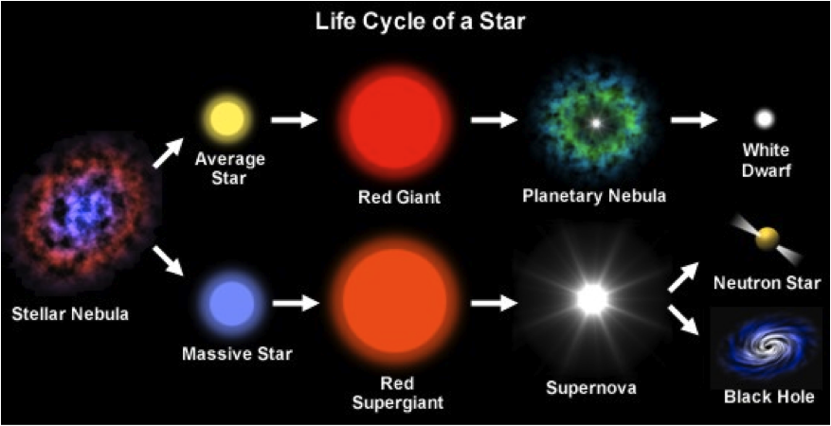
What patterns or generalizations can you make?

Slide 39
Hertzsprung-Russell Diagram
Notes:
The Hertzsprung-Russell diagram is actually a graph that illustrates the relationship that exists between the average surface temperature of stars and their absolute magnitude, which is how bright they would appear to be if they were al the same distance away. Rather than speak of the brightness of stars, the term “luminosity” is often used. Luminosity is a measure of how much energy leaves a star in a certain period of time. Generally, for stars that are at equal distances from the Earth, the more luminous a star, the brighter it is. The luminosity of stars is affected not only be temperature but also by size. The most luminous stars are affected not only by temperature but also by size. The most luminous stars would be those that are large and hot. Those that are the least luminous would be small and cool. The color of a star is determined by its surface temperature, which is illustrated on the Hertzsprung-Russell diagram.

Slide 40
Hertzsprung-Russell Diagram
What are the four important things to note about the HR Diagram?
Notes:
Most of the stars in the solar neighborhood fall on a well defined “Main Sequence”; there are very few “red giants”; there are very few “blue supergiants”; and there are a few faints stars near the bottom left of the diagram, which are white dwarfs.

