Slide 1
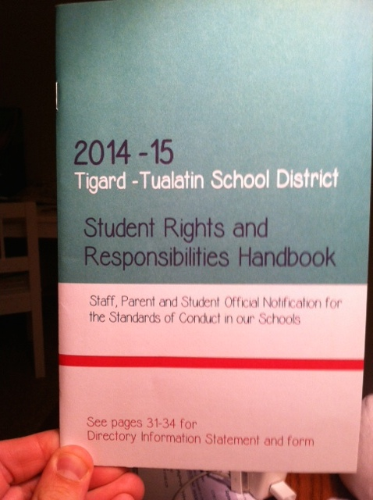
Hazelbrook’s Student Rights and Responsibilities Handbook Scavenger Hunt

Slide 2
Overview of the SRRH
The SRRH provides a description of students’, parents’, teachers’ and administrators’ jobs within our school.
All students and parents should know the rules written in the handbook.
At the end of this lesson, students will sign and return to the office the blue insert acknowledging that they’ve received and agree to the rules in the handbook.

Slide 3
Instructions:
Using your 2014-2015 Student Rights and Responsibilities Handbook, find the answers to each of the questions on the following slides.
The first student to find the answer to each question, citing the specific evidence from the text and the page number of the answer receives a Hawk High Five.

Slide 4
What to do with the Hawk High Fives…
A box will be placed on the stage at lunch on Thursday, 9/11/14 labeled “SRRH HH5s.” For every Hawk High Five placed in the box by 4:00 pm on 9/11/14, your Hawk Time will earn 1 Pride Point.
In addition, 1 Hawk High Five will be drawn from the box on Friday, 9/12. The teacher represented on that HH5 will earn a coffee of their choice the following week. The student winning the drawing will win a $5 Target gift card and ice cream at lunch for everyone in their Hawk Time.

Slide 5
Question #1
What are your responsibilities as students when it comes to what clothes you wear to school?

Slide 6
Answer:
Page 11:
“Articles of clothing that advertise illegal activities or promote the use of alcohol, tobacco or drug products, promote acts of violence and/or intimidation, or that display sexually suggestive words or pictures are not permitted in school... Properly fitting clothing is to be worn. Clothing with holes, ragged hems or cut-off hemlines, or made of transparent or fishnet fabric, or clothing that exposes the chest, legs above mid thigh, abdomen, genital area, buttocks, or undergarments shall not be worn in the buildings. Any items which are commonly considered evidence of membership or affiliation with any gang are also prohibited.”

Slide 7
Question 2
Students are entitled to express their own personal opinions as long as they don’t use what kinds of speech?

Slide 8
Answer
Page 9:
“Speech that is vulgar, lewd, indecent or…offensive.”
“Speech that is libelous or slanderous” (Explain that this means untrue and mean…spreading rumors)
“Speech that could…be viewed as promoting illegal drug use”
“Speech that threatens…to cause harm or injury to another or to school property…or that constitutes bullying and harassment.” (Puts down others or causes them to feel unsafe)

Slide 9
Question 3
What are the consequences for students that misbehave on the bus?

Slide 10
Answer
Page 13:
“Students should understand that the bus driver is responsible for the safety of students. Consequences for misbehavior may include forfeiting the right to ride and/or in the case of vandalism, payment of appropriate restitution.” (Please review the 17 expectations for riding on the bus.)

Slide 11
Question 4
Students and adults have the right to be in a school without harassment, menacing and bullying. What are harassment, menacing and bullying?

Slide 12
Answers
Page 15:
“Harassment includes intentionally annoying another either verbally, written, (on paper or electronically), or by physical contact.”
“Menacing includes attempting to place another person in fear of serious injury.”
“Bullying includes creating a hostile environment and interfering with a person’s psychological wellbeing.”
“Cyber bullying includes the use of any electronic device to harass, intimidate, bully or otherwise intend to harm another individual.”

Slide 13
Question 5
What are the district expectations in regards to iPods and cell phones?

Slide 14
Answer
Page 18:
“Students whose parents authorize them to carry communication or personal electronic devices have the responsibility to ensure any device does not disrupt the learning atmosphere. Communication or personal electronic devices that are disruptive to the educational environment will be confiscated and will be returned to the parent or guardian.”
“(TTSD) is not responsible for any property that is lost, mislaid, stolen, damaged or destroyed.”

Slide 15
Question 6
What are the consequences for a student that comes to school in possession of our under the influence of alcohol or controlled substances (drugs)?

Slide 16
Answer
Page 20:
“Possession, solicitation or being under the influence of alcohol or controlled substances, abusive chemicals, or unauthorized medication, or possession of drug-related paraphernalia will result in a minimum five school day suspension pending a substance abuse assessment by a certified drug and alcohol counselor/treatment center.”

Slide 17
Question 7
What are the consequences for a student that comes to school or the bus stop with a weapon (knife, gun or explosive) or a device that looks like a weapon?

Slide 18
Answer
Page 26:
“Possessing or using weapons including “look-alikes” or any other inappropriate item that is a threat to the safety or effective operation of the school is not allowed. Students who promote or beome involved in such activities can expect to be held responsible and disciplined for their actions…Disciplinary action will include suspension and/oran alternative to expulsion placement.”

Slide 19
Next Steps
Remember to place your Hawk High Fives in the box on the stage during lunch today.
Please complete the blue insert in the middle of your SRRH and return it to your Hawk Time teacher.

