Slide 1
Hazelbrook’s Emergency Response
A student guide for communicating and responding during emergencies.
October 2, 2014

Slide 2
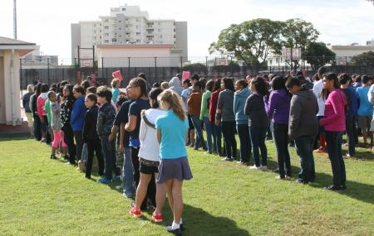
Goals/Objectives
When an emergency announcement is made, students will safely and appropriately respond.

Slide 3
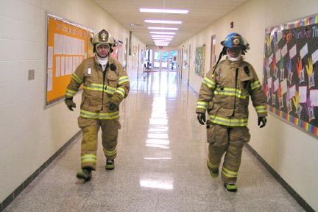
4 Major Actions
Instructions will be announced over the school intercom with a specific phrase (repeated once) for:
Lockout
Lockdown
Shelter
Evacuate

Slide 4
Lockout
Dangerous situation outside the building.
PA Announcement: “Lockout! Secure the perimeter. Lockout! Secure the perimeter.”
Students move inside the building and into the nearest classroom.
Exterior doors are locked.
Business as usual inside the classroom.

Slide 5
Lockdown
Dangerous situation inside the school.
PA Announcement: “Lockdown! Locks, lights out of sight. Lockdown! Locks, lights, out of sight.”
Students move to corner of the room invisible from the outside. Wait silently for further instructions.
May last for hours.
Do not respond to fire alarm unless actual fire presents danger.
Follow instructions from law enforcement to evacuate if necessary.
If outside or in hallway, use your safety instincts. If it’s unsafe to enter the building or classroom, run to the nearest safe location.

Slide 6
Lockdown Practice
Teacher: Please say aloud the lockdown announcement and repeat once.
Students: Silently move away from a place where you can be seen and wait for further instructions.

Slide 7
Evacuate
Occurs when students need to be moved away from an unsafe situation.
Emergyency Alarm will ring or PA Announcement: “Evacuate to ______________! Evacuate to ______________!”
Example: “Evacuate to the field! Evacuate to the field!”
Students:
Leave items behind.
Form single file line.
Be prepared for other instructions. (cover your head, crawl, hold your neighbor’s hands)
Follow your teacher silently to the stated location.

Slide 8
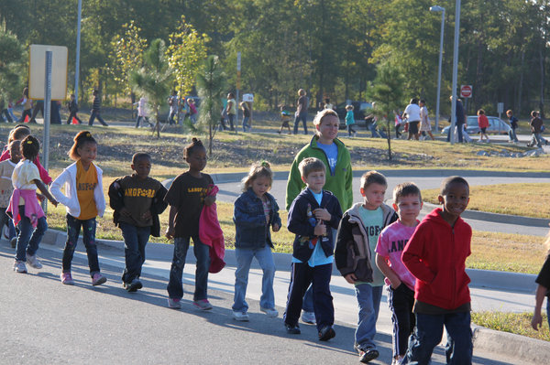
Evacuation Practice
Teacher: “Evacuate out of the building. Evacuate out of the building.”
Students:
Form single file line silently.
Follow your teacher silently to evacuation location.
Wait silently for further instructions

Slide 9
Shelter
Listen for type of hazard and shelter method.
PA Announcement: “Shelter for earthquake! Drop, cover and hold.”
“Shelter for hazmat and seal!”
“Shelter for tornado. Drop, cover and hold.”
“Shelter in silence.”

Slide 10
Shelter Practice
Teacher: “Shelter for earthquake! Drop, cover and hold. Shelter for earthquake! Drop, cover and hold.”
Students:
Move under a table or desk.
Place hands over your head and hold on to leg of table.
Wait silently for further instructions.

