Slide 1
Chapter 4 Review with Table Partner
Get One White board
One Marker
One Eraser

Slide 2
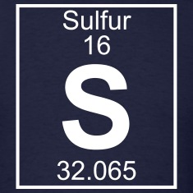
Draw the atom Sulfur

Slide 3
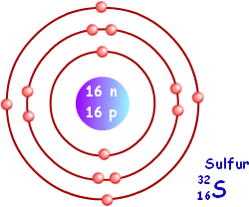
Draw the atom Sulfur

Slide 4
Is Sulfur Reactive or Stable? Explain.

Slide 5
Is Sulfur Reactive or Stable?
Reactive- last orbit ½ full

Slide 6
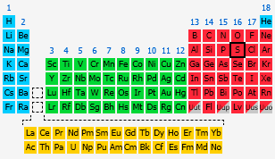
Is Sulfur a Metal, Non-metal or Metalloid?

Slide 7
Non-metal

Slide 8
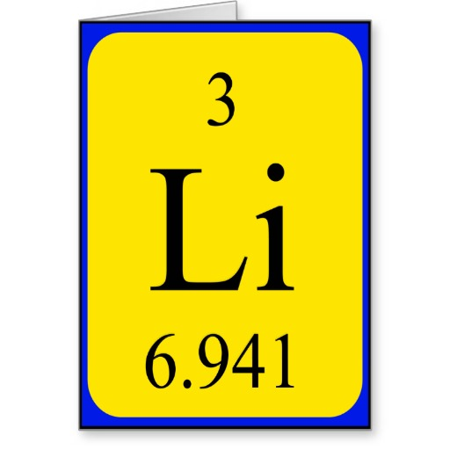
Draw the atom Lithium

Slide 9
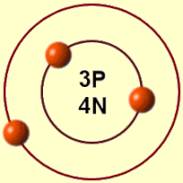
Draw the atom Lithium

Slide 10
Is Lithium reactive or stable? Explain.

Slide 11
Is Lithium reactive or stable?
Very Reactive- last orbit almost empty

Slide 12
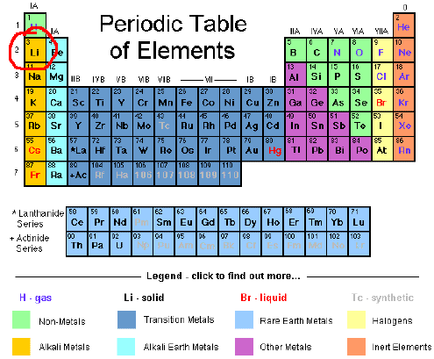
Is Lithium a Metal, Non-Metal or Metalloid?

Slide 13
Metal

Slide 14
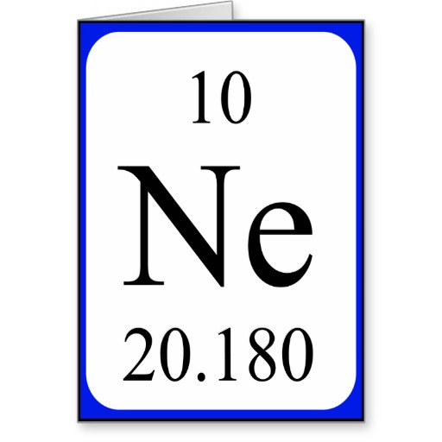
Draw the atom Neon

Slide 15
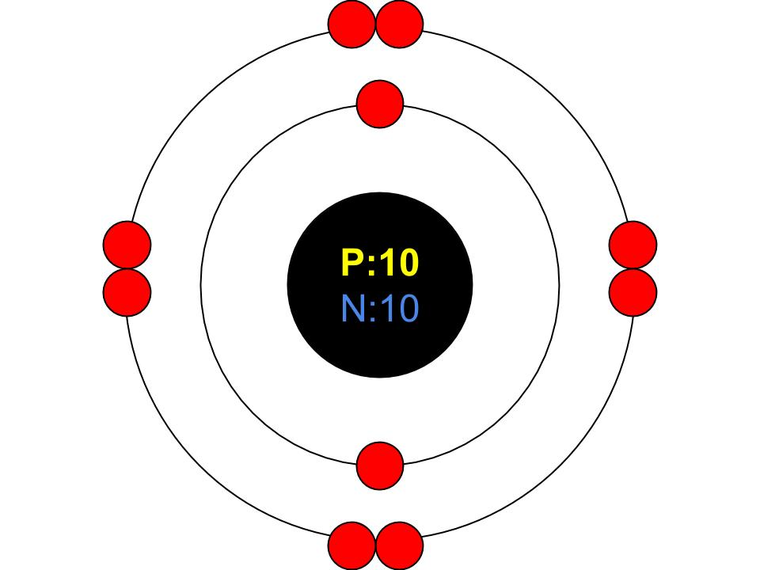
Draw the atom Neon

Slide 16
Is Neon reactive or stable ? Explain.

Slide 17
Is Neon reactive or stable ?
Stable- last orbit full

Slide 18
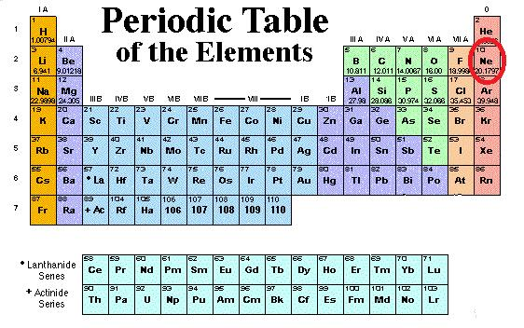
Is Neon a Metal, Non-metal or Metalloid ?

Slide 19
Non-metal

Slide 20
What determines if an atom is stable or reactive?

Slide 21
What determines if an atom is stable or reactive?
If the outer orbit is ALMOST full or ALMOST empty it is highly reactive. If it is all the way full it is stable.

Slide 22
What am I?
Metal, Non-Metal or Metalloid
Conduct electricity
Malleable
Conduct heat

Slide 23
What am I?
Metal, Non-Metal or Metalloid
Conduct electricity
Malleable
Conduct heat
Metal

Slide 24
What am I?
Metal, Non-Metal or Metalloid
Brittle
Low melting point
Low density

Slide 25
What am I?
Metal, Non-Metal or Metalloid
Brittle
Low melting point
Low density
Non-Metal

Slide 26
What am I?
Metal, Non-Metal or Metalloid
Hydrogen

Slide 27
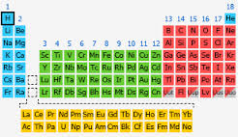
What am I?
Metal, Non-Metal or Metalloid
Hydrogen
Non-Metal

Slide 28
What am I?
Metal, Non-Metal or Metalloid
Solid
Metallic luster
Brittle
Tend to gain e⁻

Slide 29
What am I?
Metal, Non-Metal or Metalloid
Solid
Metallic luster
Brittle
Tend to gain e⁻
^{Metalloid}

Slide 30
What am I?
I tend to loose electrons to become stable and chemically bond

Slide 31
What am I?
I tend to loose electrons to become stable and chemically bond
I’m a Metal

Slide 32
What am I?
I tend to gain electrons to become stable and chemically bond

Slide 33
What am I?
I tend to gain electrons to become stable and chemically bond
Metal or Metalloid

Slide 34
What is the name of family 1A?

Slide 35
What is the name of family 1A?
Alkali Metals

Slide 36
What chemical property does EVERY element in the Alkali Metal family have in common?

Slide 37
What chemical properties do EVERY element in this family have in common?
Highly reactive
They have 1 ve⁻

Slide 38
Elements in this family are highly reactive and lose valence electrons
Why???

Slide 39
Elements in this family are highly reactive and lose valence electrons
They lose their ve⁻
to be stable!
It’s less energy to lose one than gain 7!
Notes:
Stable means a full out energy level.

Slide 40
What are the periodic properties of the Alkali family?

Slide 41
What are the periodic properties of the Alkali family?
1 ve
Highly reactive
Each period becomes more reactive
Easier to remove ve with each period
Notes:
Unstable with 1 ve, so they lose to gain stability. Easier b/c the 1 ve is further from the nucleus therefore more reactive

Slide 42
What is the name of family 7A?

Slide 43
What is the name of family 7A?
Halogen Family

Slide 44
What chemical property does EVERY element in the Alkali Metal family have in common?

Slide 45
What chemical property does EVERY element in the Alkali Metal family have in common?
Highly reactive
They have 7 ve⁻

Slide 46
Elements in the Halogen family are highly reactive and gain valence electrons
Why?

Slide 47
Elements in the Halogen family are highly reactive and gain valence electrons because
They gain 1 ve⁻
to be stable!
It’s less energy to gain 1 than give away 7!

Slide 48
What are the periodic properties of the elements in the Halogen family?

Slide 49
What are the periodic properties of the elements in the Halogen family?
They all have 7 ve
Highly reactive
Each period becomes less reactive
Notes:
As you go down group 7 the atom becomes larger, and there is less attraction between the positive nucleus and the outermost electrons.
As a result it becomes harder to attract an electron.

Slide 50
Draw the Lewis Dot Structure of Sulfur

Slide 51
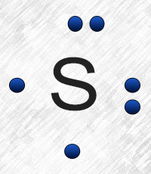
Draw the Lewis Dot Structure of Sulfur

Slide 52
How many bonds can Sulfur make?

Slide 53
How many bonds can Sulfur make?
Answer: 2

Slide 54
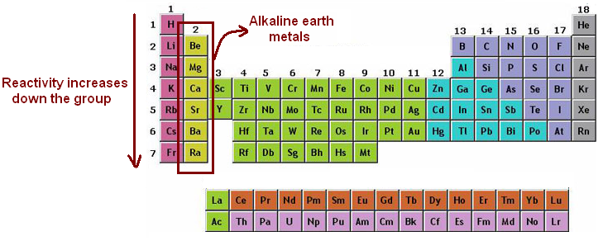
If group 1 bond with group 7/17 it will form what type of bond?
A) Covalent B) Metallic C) Ionic

Slide 55
If group 1 bond with group 7/17 it will form what type of bond?
C) Ionic

Slide 56
If group 2 bond with group 7/17 it will form what type of bond?
A) Covalent B) Metallic C) Ionic

Slide 57
If group 2 bond with group 7/17 it will form what type of bond?
C) Ionic

Slide 58
If group 1 bond with group 1 it will form what type of bond?
A) Covalent B) Metallic C) Ionic

Slide 59
If group 1 bond with group 1 it will form what type of bond?
B) Metallic

Slide 60
If the light green group bonds with itself it will form what type of bond?
A) Covalent B) Metallic C) Ionic

Slide 61
If the light green group bonds with itself it will form what type of bond?
B) Metallic

