Slide 1
Periodic Table – Part II
Standard: 8.1P.2 EXPLAIN how the Periodic Table is organized … based on the physical and chemical properties

Slide 2
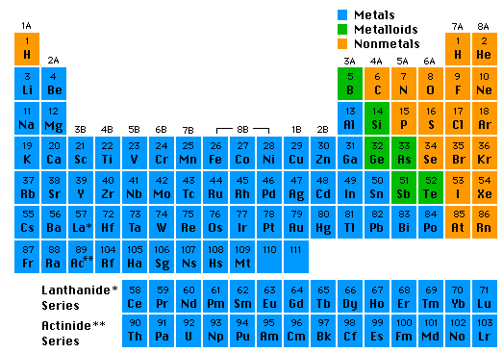
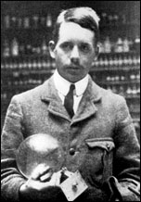
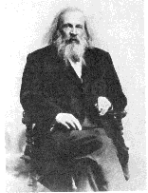
The Periodic Table
Dmitri Mendeleev (1834 - 1907)
Henry Moseley (1887 -1915)
Notes:
Mendeleev atomic mass, Moseley atomic number

Slide 3
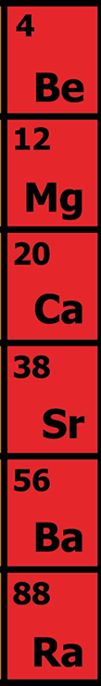
Elements are arranged:
Vertically into Groups or Families
Why?
Horizontally Into Periods

Slide 4



If you looked at one atom of every element in a group you would see…
Each atom has the same number of electrons in its outermost shell (valence electrons)

Slide 5
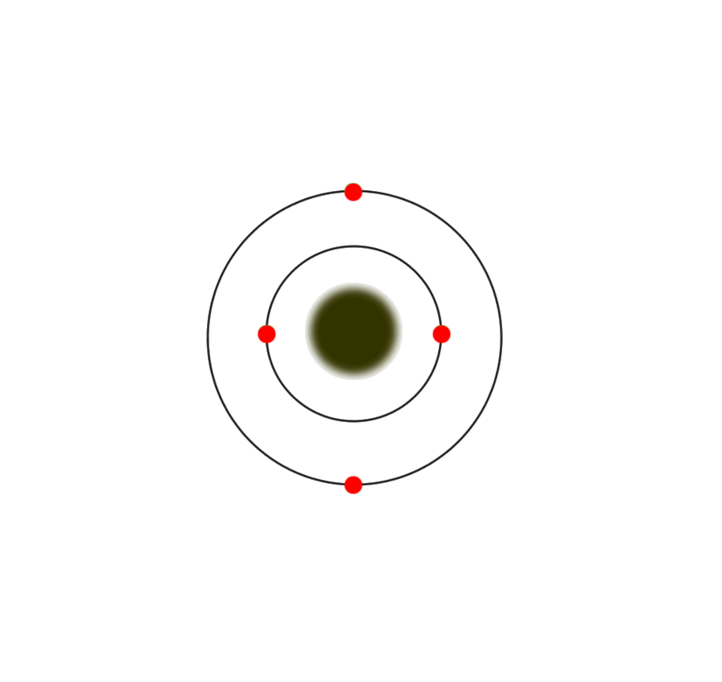
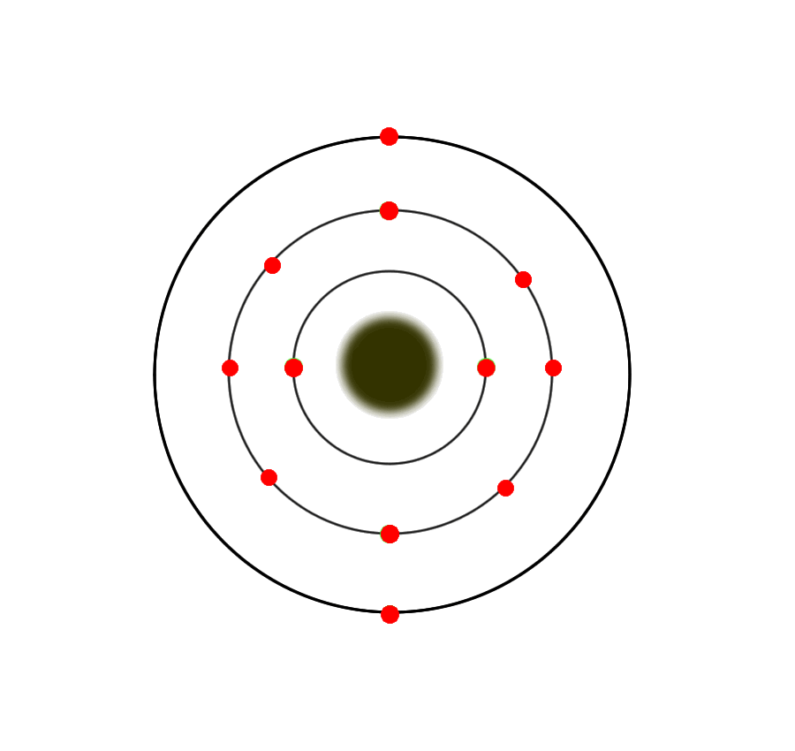
Group 2A atoms all have 2 electrons in their outer shells
Be (Beryllium)
Atom
Mg (Magnesium) Atom

Slide 6

The number of outer or “valence” electrons in an atom affects the way an atom bonds.
The way an atom bonds determines many properties of the element.
This is why elements within a group usually have similar properties.
Highly Reactive!
Unreactive
“inert”

Slide 7
As you look across a “period” on the PT
you would see…
Each atom has the same number of electron shells (energy levels).
An example…

Slide 8
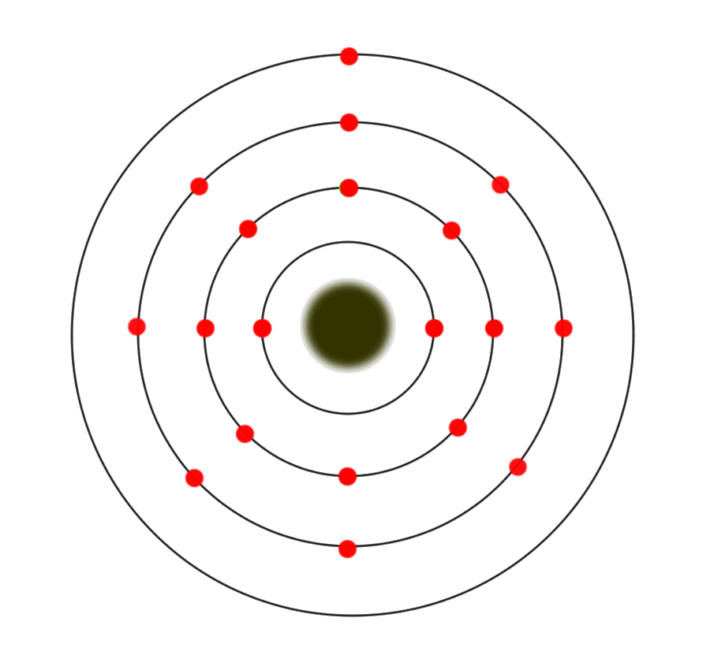
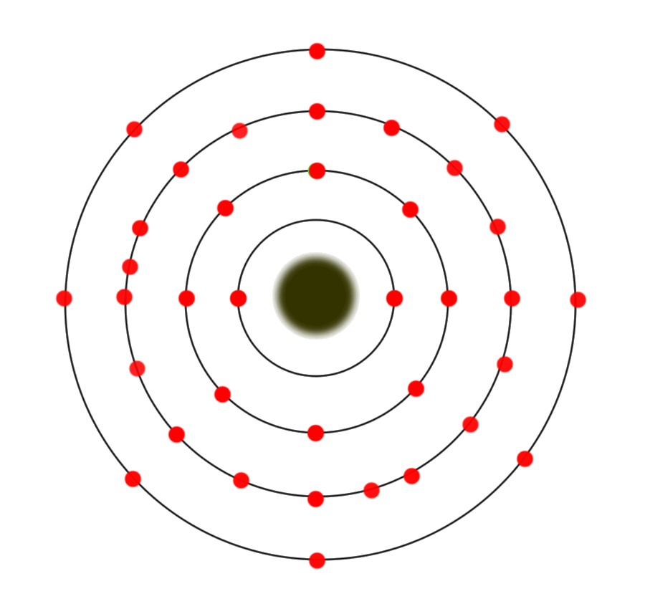
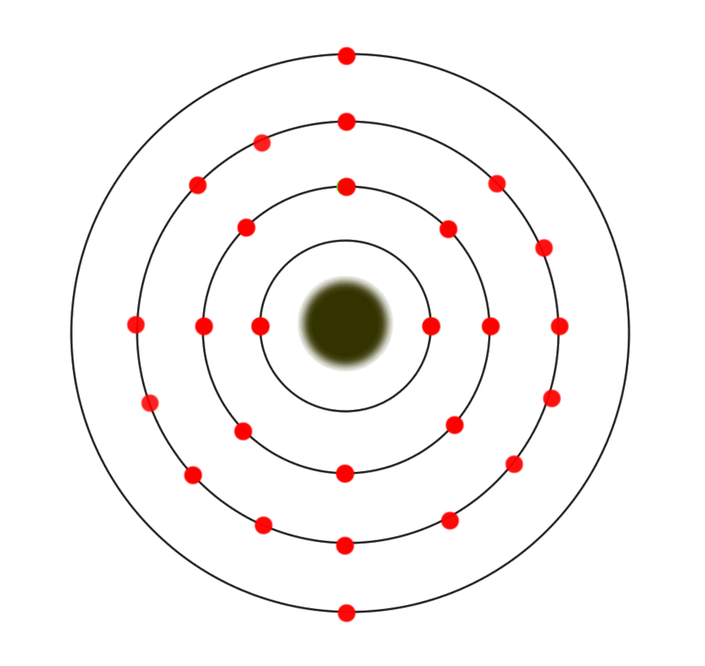
The period 4 atoms each have 4 electron containing shells
4th Shell
K (Potassium)
Atom
Kr (Krypton)
Atom
Fe (Iron) Atom

Slide 9
Each group has distinct properties
The periodic Table is divided into several groups based on the properties of different atoms.

Slide 10
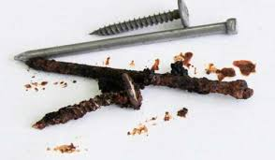
Properties of Metals
Physical Properties
Malleable
Ductile
Thermal conductivity
Electrical conductivity
Some are magnetic
Chemical Property
Chemical reactivity

Slide 11
Properties of Metals
Physical Properties: A physical property of a pure substance is anything that can be observed without changing the identify
Malleable: can be hammered or rolled into flat sheets…
Ductile: can be pulled out into long wires
Thermal conductivity: transfer heat
Electrical conductivity: carry electric current
Some are magnetic: electrons are free to spin and create magnetic fields
Chemical Property: Reactive, Lose e⁻ to other atoms
Notes:
A physical property of a pure substance is anything that can be observed without changing the identify

Slide 12
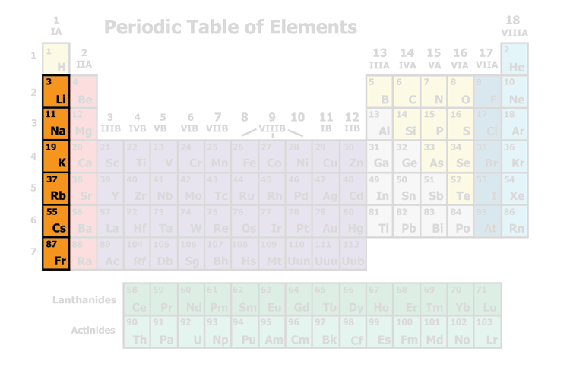
Alkali Metals
Group 1A (Not H)
Soft, silvery coloured metals
Very reactive!!! Because???
Never found alone in nature – always bonded with another atom. Why?
Only 1 valence electron!
Only 1 ve! It loses the ve to have a full outer energy level!

Slide 13
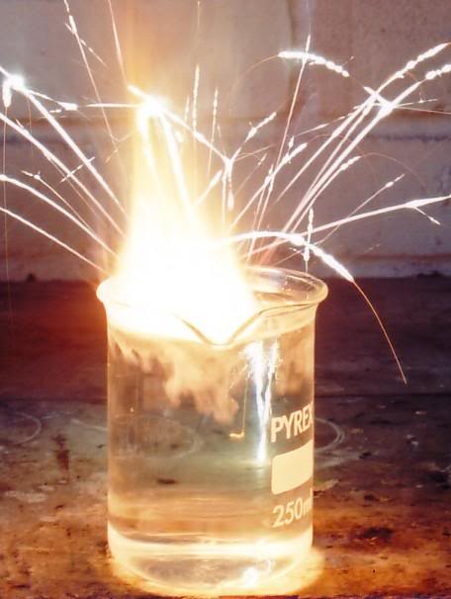
Group 1A: Alkali Metals
Reaction of potassium + H₂O
Cutting sodium metal
Notes:
Hyperlink in the image of reaction of K to water

Slide 14
Alkali Metals reacting with water:
Li (Lithium) – least reactive
Na (Sodium)
K (Potassium)
Rb (Rubidium)
Cs (Cesium) – more reactive
What would you expect from Francium?!?!

Slide 15
Alkali Metals :
Label as Alkali Metals
Do NOT include Hydrogen

Slide 16
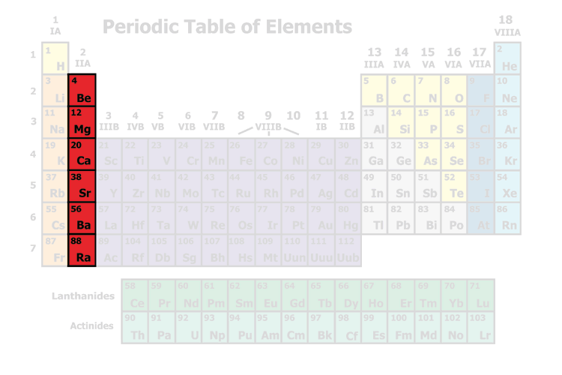
Alkaline Earth Metals
Silvery-White Metals
Fairly reactive (Why?)
Not found alone in nature (Why?)
Many are found in rocks in the earth’s crust
Hard and dense
Melt at high temperatures
Only 2 ve!
Only 2 ve! It loses the ve to have a full outer energy level!
Notes:
Hyper-link for “Melt at high temps” http://www.ptable.com/
Use the PT – move the temperature lever and have students watch the states of matter and the temperatures to see the temps a substance changes from Solid to Liquid to Gas

Slide 17
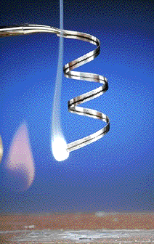
Group 2A: Alkaline Earth Metals
Magnesium
Magnesium oxide

Slide 18
Alkaline Earth Metals
Label as Alkaline Earth Metals

Slide 19
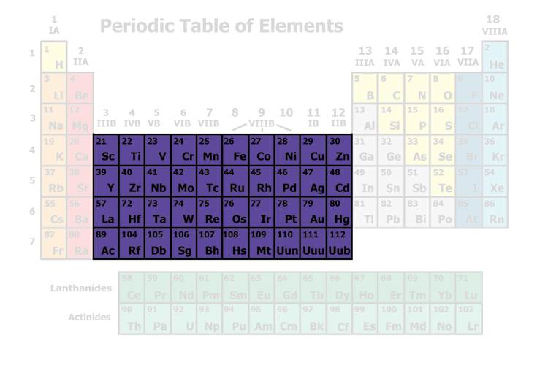
Most are good conductors of electricity
Transition Metals
Malleable (easily bent/hammered into wires)
Malleable (easily bent/hammered into wires o

Slide 20
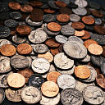
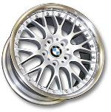



Things made with
Transition Metals

Slide 21
Transition Metals
Label the group: Transition Metals

Slide 22
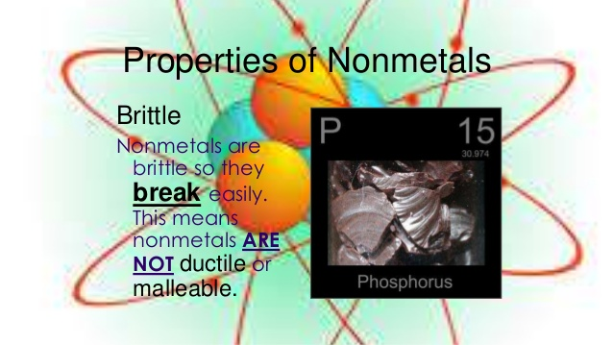
Dull, Non-ductile, Non-malleable, Low melting and boiling point, low electrical conductivity, poor heat conductivity, low tensile strength.

Slide 23
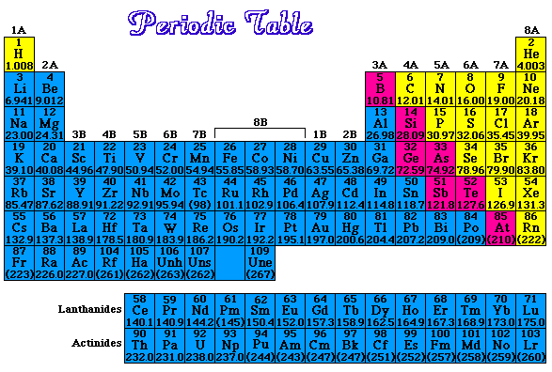
Nonmetals
(Yellow)

Slide 24
Nonmetals
(Yellow)
Physical Properties:
Dull
Brittle
Low melting and boiling point
Low/no electrical conductivity
Poor heat conductivity
Low tensile strength
Chemical Properties: tend to gain ve

Slide 25
Nonmetals
Label the Non-metals

Slide 26
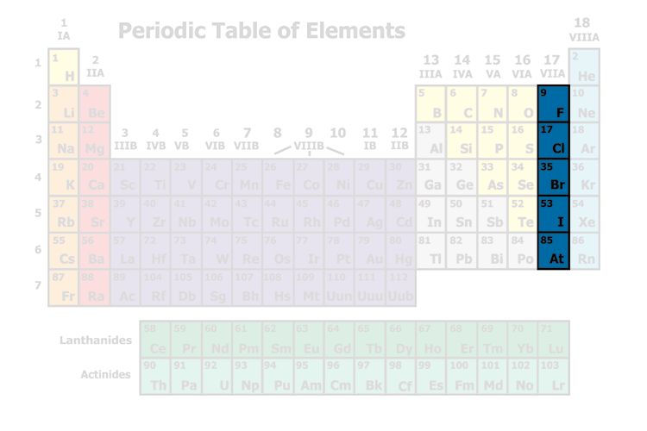
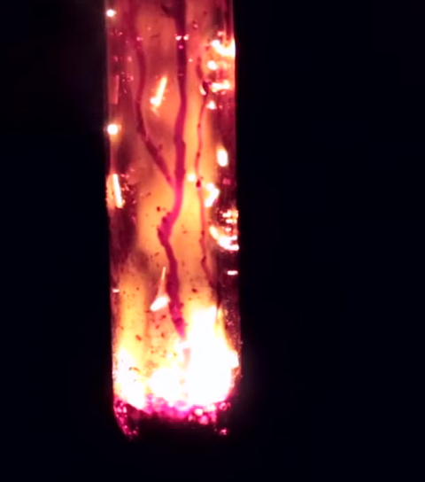
Nonmetals
Halogens
Most are poisonous
Fairly reactive – react with alkali metals (eg) Na⁺ and Cl⁻
Notes:
Click on image when in “present view” and a youtube will open 5 min 19 sec
Chlorine Gas was used as a chemical weapon during World War I.
It was used by the Germans in World War II.

Slide 27
Nonmetals
Halogens
Label the Halogens
Notes:
Chlorine Gas was used as a chemical weapon during World War I.
It was used by the Germans in World War II.

Slide 28
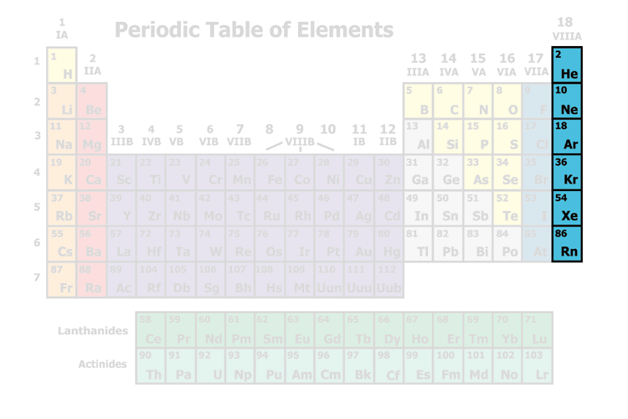
Nonmetals
Noble Gases
Unreactive
Gases at room temperature

Slide 29
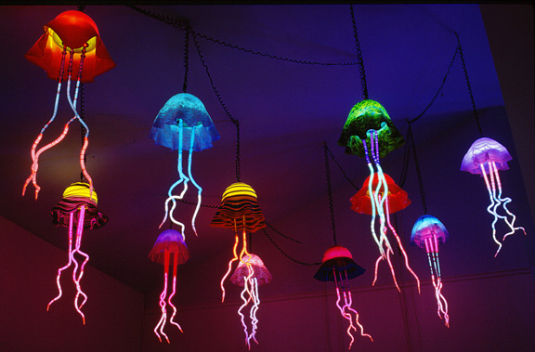
Jellyfish lamps made with noble gases artist- Eric Ehlenberger
Notes:
Ne (Neon): orange-red, Hg (Mercury): light blue, Ar (Argon): pale lavender, He (Helium): pale peach, Kr (Krypton): pale silver, Xe (Xenon): pale, deep blue

Slide 30
Nonmetals
Noble Gases
Label the Noble Gases

Slide 31
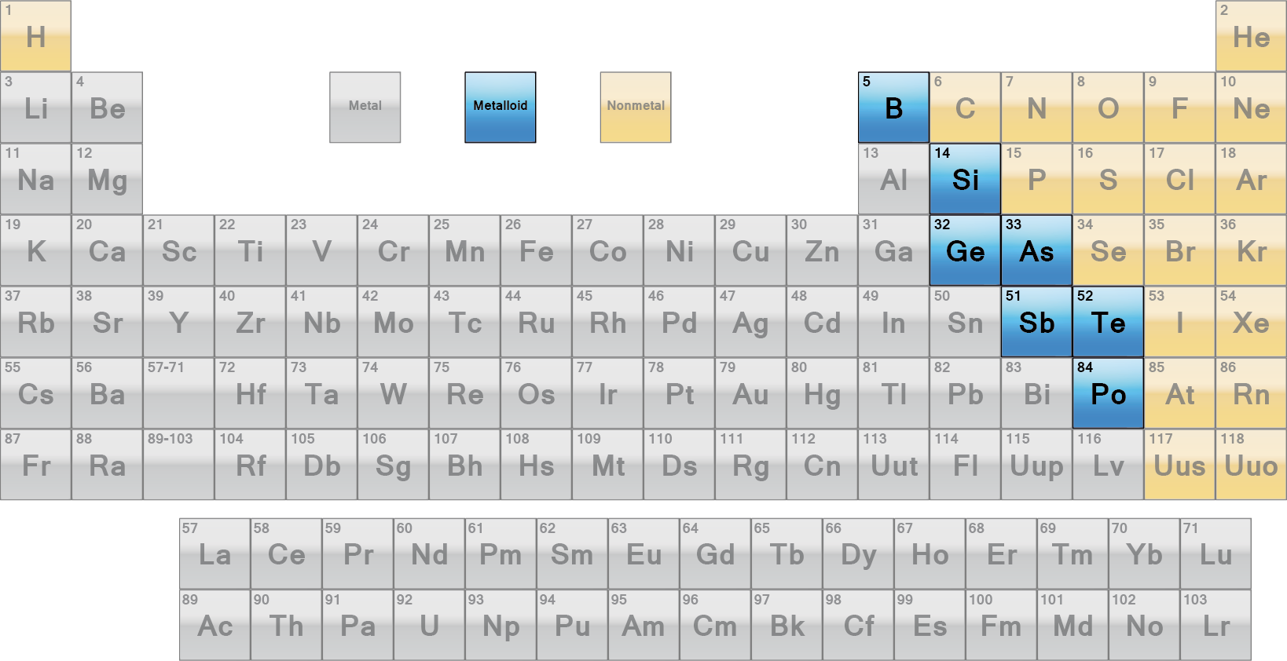
Metalloids/
Semiconductors
Metalloids lie on either side of the “staircase”
They share properties with both metals and non-metals
Notes:
Si (Silicon) and Ge (Germanium) are very important “semi-conductors”

Slide 32

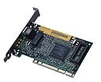


What are semiconductors used in?

Slide 33
Metalloids/
Semiconductors
Label as Metalloids
Notes:
Si (Silicon) and Ge (Germanium) are very important “semi-conductors”

Slide 34
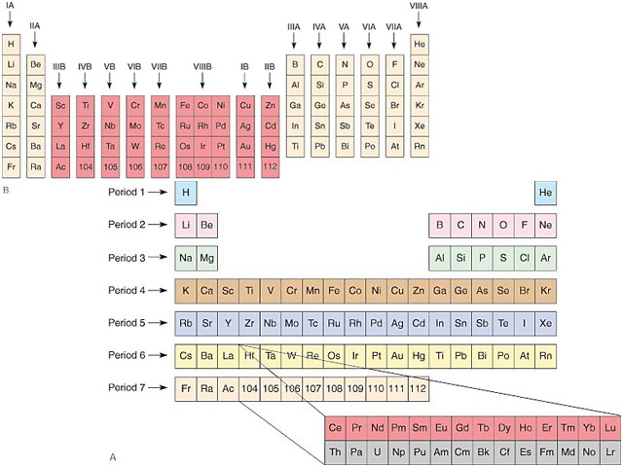
(A) Periods of the periodic table, and (B) groups of the periodic table.

Slide 35
Metalloids
Label the Metalloids
Color the Metalloids blue
Notes:
Si (Silicon) and Ge (Germanium) are very important “semi-conductors”

Slide 36
Color Code (Color) your periodic table
Nonmetals = Yellow
Metals = Blue
Metalloids = Pinkish color

Slide 37
Chemical “Groups”
IA are called alkali metals because they react with water to form an alkaline solution (basic)
  They are very reactive
Group IIA are called the alkaline earth metals because they are reactive, but not as reactive as Group IA.
    They are also soft metals
Group VIIA are the halogens
    These need only one electron to fill their outer shell
    They are very reactive
Group VIIIA are the noble gases as they have completely filled outer shells
    They are almost non-reactive.

Slide 38
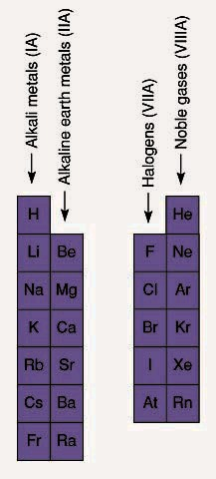
Four chemical families of the periodic table: the alkali metals (IA), the alkaline earth metals (IIA), halogens (VII), and the noble gases (VIIIA).

Slide 39
Metal: Elements that are usually solids at room
temperature.
Most elements are metals.
Non-Metal: Elements in the upper right corner of the
periodic Table. Their chemical and physical properties
are different from metals.
Metalloid: Elements that lie on a diagonal line between
the metals and non-metals. Their chemical and
physical properties are intermediate between the two.

Slide 40
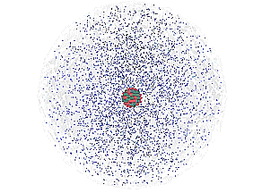
The Atom
An atom consists of a
nucleus
  (of protons and neutrons)
electrons in space about the nucleus.
Electron cloud
Nucleus

Slide 41
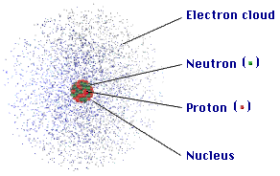
ATOM
COMPOSITION
The atom is mostly
empty space
protons and neutrons in the nucleus.
the number of electrons is equal to the number of protons.
electrons in space around the nucleus.
extremely small. One teaspoon of water has 3 times as many atoms as the Atlantic Ocean has teaspoons of water.

Slide 42
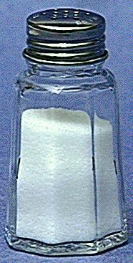
Compounds
  composed of 2 or more elements in a fixed ratio
  properties differ from those of individual elements
  EX: table salt (NaCl)

Slide 43
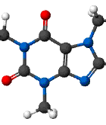
A MOLECULE is 2 more atoms bonded together – they may be the same element (ie diatomic molecule) or they may be different elements (ie caffeine)
Composition of molecules is given by a MOLECULAR FORMULA
H₂O
C₈H₁₀N₄O₂ - caffeine

Slide 44
Isotopes
Atoms of the same element (same Z) but different mass number (A).
Boron-11 (¹¹B) has 5 p and 6 n
Boron-12 (¹²B) has 5 p and 7 n
¹¹B
¹⁰B

Slide 45
Atomic Symbols
Show the name of the element, a hyphen, and the mass number in hyphen notation
sodium-23
Show the mass number and atomic number in nuclear symbol form
mass number
²³ Na
atomic number ¹¹

Slide 46
IONS
IONS are atoms or groups of atoms with a positive or negative charge.
Donating an electron from an atom gives a CATION with a positive charge
Accepting an electron to an atom gives an ANION with a negative charge
To tell the difference between an atom and an ion, look to see if there is a charge in the superscript! Examples: Na⁺ Ca⁺² I⁻ O⁻² Na Ca I O

Slide 47
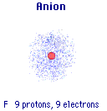
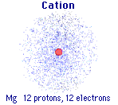
Forming Cations & Anions
A CATION forms when an atom loses one or more electrons.
An ANION forms when an atom gains one or more electrons
Mg --> Mg²⁺ + 2 e-
F + e- --> F⁻

Slide 48

Learning Check – Counting
State the number of protons, neutrons, and electrons in each of these ions.
³⁹ K⁺ ¹⁶O ⁻² ⁴¹Ca ⁺²
19 8 20
#p⁺ ______ ______ _______
#nº ______ ______ _______
#e⁻ ______ ______ _______

Slide 49
  Elements with 1, 2, or 3 electrons in their outer shell tend to lose electrons to fill their outer shell and become cations.
    These are the metals which always tend to lose electrons.
  Elements with 5 to 7 electrons in their outer shell tend to gain electrons to fill their outer shell and become anions.
    These are the nonmetals which always tend to gain electrons.
  Semiconductors (metalloids) occur at the dividing line between metals and nonmetals.

