Slide 1
Observations
How we look at things in science

Slide 2
What is observation?
Observations are made in science. They are made by using:
Senses
Tools
  increase accuracy & precision
Facts not opinions.

Slide 3
Two types of Observation
Qualitative
Quantitative

Slide 4
Qualitative Observations
Hard to measure
Describes the qualities of something
  Color
  Taste
  Sound

Slide 5
Quantitative Observations
Can be expressed in numbers
Can be counted or measured
  Amounts
  Temperature
  Mass
  Length
Allow us to communicate specifics
Tools are used to communicate data
Observations are collected in data tables

Slide 6
Inference
Drawing a conclusion based on data and observation
The process of drawing a conclusion from given evidence.
Practice:
Observations:
  I hear people screaming
  I smell cotton candy, popcorn, and hamburgers
  I see a lot of people
Inference = ?

Slide 7
Observation Inference
That plant is extremely wilted.
The car stopped running
The Diamondbacks are leading their division
That plant is extremely wilted due to a lack of water.
The car stooped running because it was out of gas.
The Diamondbacks are leading their division because they are playing well right now.

Slide 8
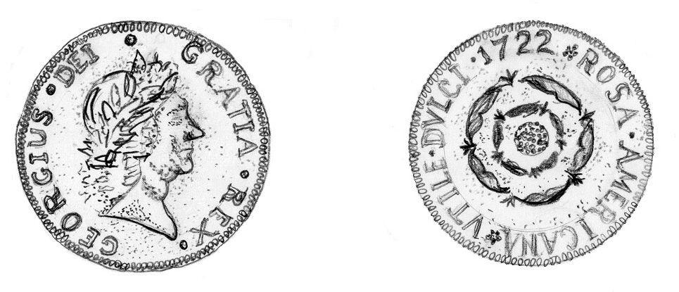
Observation or
Inference
There is a representation of a face on one side of the coin.
The Latin word "Dei" means "God.“
The coin was made by deeply religious people.
The date 1722 is printed on one side of the coin.
The coin was made in 1722.
The face on the coin is a representation of the nation's president.

Slide 9
Observation or
Inference
Let’s Practice….
Look at the picture & decide if the statement is an

Slide 10
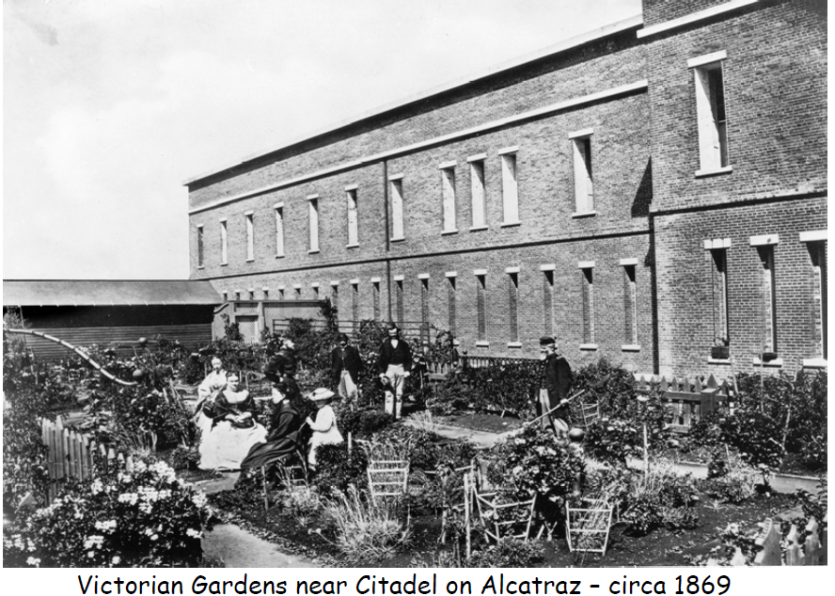
The narrow windows were used as rifle slits.
Inference

Slide 11
There was a garden located outside the Citadel.
Observation

Slide 12
Gardens were an important part of everyday life during the military years on Alcatraz Island.
Inference

Slide 13
People in the garden are in mourning.
Inference

Slide 14
Men were required to wear jackets and women were required to wear dresses
Inference

Slide 15
The citadel was made of brick.
Observation

Slide 16
There is a picket fence.
Observation

Slide 17
People used to spend more time outside.
Inference

Slide 18
There are eight people in the photograph.
Observation

Slide 19
The garden provided food for the families living on Alcatraz.
Inference

Slide 20
There were no cannons on Alcatraz..
Observation

Slide 21
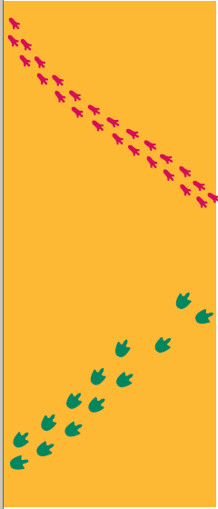
Look at these two sets of animal tracks.
List 3 OBSERVATIONS
Make an INFERENCE

Slide 22
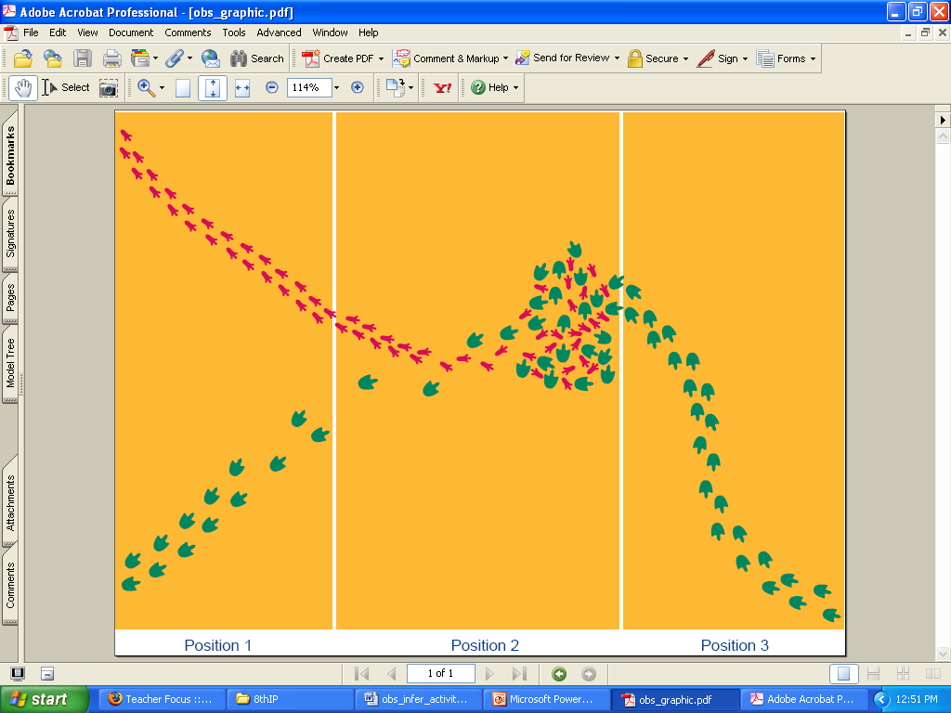
Now what do you think?
Make 3 OBSERVATIONS
Make an INFERENCE

Slide 23
Now what do you think?
Make 3 OBSERVATIONS
Make an INFERENCE

Slide 24
When to use observation & inference…
During experiments, record observations NOT inferences
Inferences may be used when writing the conclusion in your lab report.

Slide 25
References
www.middleschoolscience.com/...Observation_Inference-isn.ppt
www.learnnc.org/lp/pages/998
www.nps.gov/.../upload/Questioning_Artifacts-Observation_worksheet.pdf

