Slide 1
Main Idea? Metamorphic Rocks From the Greek words “meta” meaning _______________, and ”morph” meaning _____________________________.
Definition
Classification
Examples
Texture
Main Idea / Picture
Main Idea / Picture

Slide 2
Main Idea? Metamorphic Rocks From the Greek words “meta” meaning _______________, and ”morph” meaning _____________________________.
Definition
A rock that forms from another r________ that is changed by h_______ and/or p____________.
Classification by
T____________
C____________ and m________ makeup
Examples
Texture
Main Idea / Picture
Foliated – grains arranged in p________________ l____________ or bands
Picture
Main Idea / Picture
Nonfoliated – the mineral grains are arranged r___________________
Picture

Slide 3
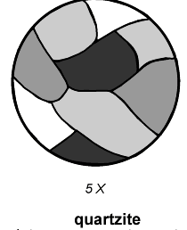
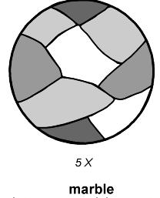
Main Idea? Metamorphic Rocks From the Greek words “meta” meaning _______________, and ”morph” meaning _____________________________.
Definition
A rock that forms from another rock that is changed by heat and/or pressure.
Classification by
Texture
Chemical and mineral makeup
Examples
Slate
Marble
Schist
Gneiss
Quartzite
Texture
Main Idea / Picture
Foliated – grains arranged in parallel layers or bands
(slate, schist, gneiss)
Main Idea / Picture
Nonfoliated – the mineral grains are arranged randomly (marble, quartzite)

