Slide 1
Welcome! Ms. K. Brown’s Hawk Time
Sit in your color seat – you choose which one, there are three!
Make a Name Tent – see teacher example.
When the bell rings, be SILENTLY in your color seat

Slide 2
Welcome! Ms. K. Brown’s Hawk Time
Teacher takes roll – listen and say “here” when your name is called
Finish making your Name Tent
Start the Classroom Scavenger Hunt

Slide 3
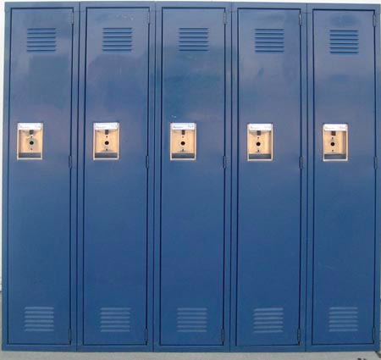
Locker Reminders and Distribution
September 9, 2015
7th Grade: 9:55 – 10:20
8th Grade: 10:30 – 10:55

Slide 4
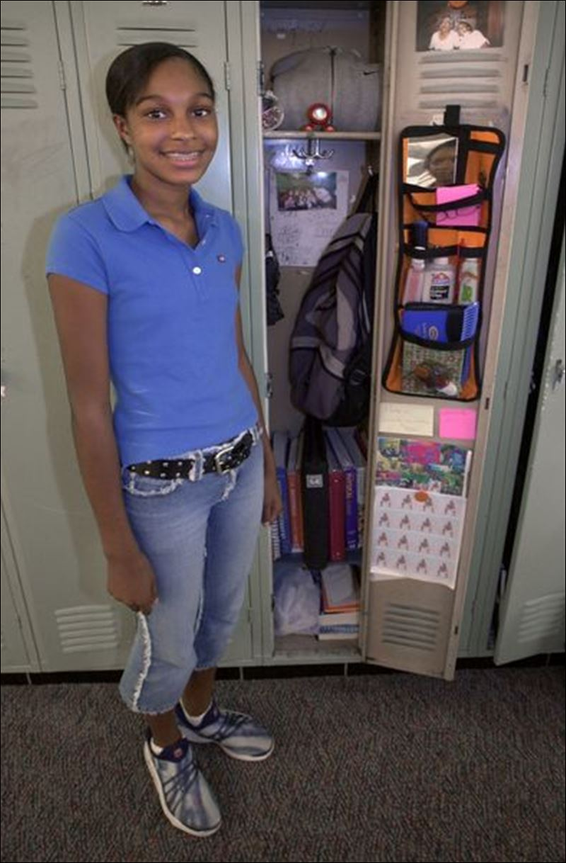
Locker Partners
Boys must have a boy partner, girls a girl partner.
Partner must be on the same team as you.
Pick someone you trust that has like interests (organized, neat, on time, etc.)

Slide 5
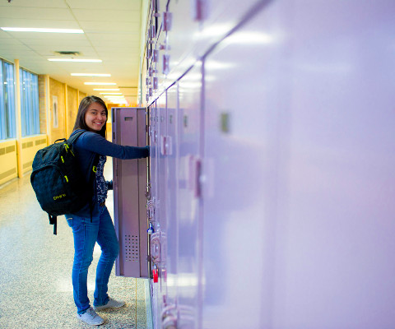
Locker Partners (cont.)
Locker partners are permanent. Make sure you make a good choice.
Best friends are often times not the best locker partner.
See an adult for help finding a partner if needed.

Slide 6
Locker Security Tips
Never share your locker combination with anyone.
Once you close your locker, spin the dial to make sure it’s locked.
Leave valuable items at home. (phones, mp3 players, tablets, etc.) The school is not responsible if these disappear and they will be taken by school staff if used during school.

Slide 7
Tips for Opening Lockers
Practice today.
Get adult help if needed. (Don’t share your combination with friends!)
Keep your combination written in your binder until you have it memorized.
If you’re having locker issues, report to your teacher first, then the main office for assistance.

Slide 8
Remember that lockers are school property!
Lockers can be searched by school administrators at any time.

Slide 9
Expectations: Locker Check-Out
Take your schedule with you!
Appropriate voice volume
Boy / Girl Lines
Turn your schedule towards the teachers checking out lockers and say you last, and first name
Practice opening your locker
Return to class ASAP and work on Scavenger Hunt

Slide 10
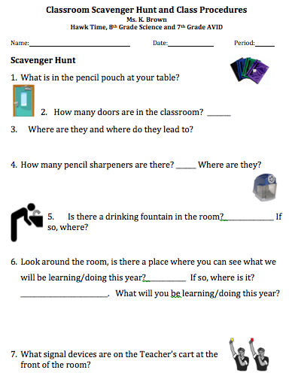
Work on your Class Scavenger Hunt

Slide 11
HMS Binder Introduction
September 9, 2015
Notes:
The following lesson will introduce your Hawk Time students to the AVID program and our HMS binder system.

Slide 12
Objective
By the end of today’s lesson, you will be able to identify the components of the HMS binder system by setting up your own binder.

Slide 13
Why Is This Important?
Maintaining an organized binder is one of our main focuses at HMS this year, as it has a direct impact on your success in all classes!
The ideal binder size is two or three inches so that all of your work for each class can be stored in one single binder.
This way, you will have all of your materials with you in each class and will arrive ready to learn!

Slide 14
Hazelbrook is an AVID school!
In successful AVID schools, ALL students use a one-binder organizational system.
It is expected that all HMS students will be carrying one binder to all classes.

Slide 15
The Assignment Log:
Notes:
Every class will have their own Assignment Log, placed in each section of your binder.
Here is an example from a math class.
The goal is to create a log of your assignments that you can use to track your completion and should look similar to your grade/assignments in Synergy.
(You can share your own example in your Hawk Time here.)

Slide 16
Time To Set Up Your Binder:
Place all of your supplies in your binder in the following order:
A zipper pouch with supplies
(2+ pens, 2+ pencils, erasers, highlighters, etc.)
HMS Quarterly Calendar
Filler Paper (lined/graph)
7 Dividers
One section per class in the order of your day.
One Assignment Log per section.
Notes:
At this time, share the binder that you created during our Inservice week.
Walk through the components of the binder by showing students.
As you share each component, have your Hawk Time students place that item in their binder.

Slide 17
A FEW DETAILS…
Put all of your papers in the back of each section prior to the end of the period.
Clean out your section at the end of each unit or quarter.
Do not stick papers in the front pocket of your binder. Use the rings.
There will be weekly binder checks in Hawk Time to earn a “Binder High Five”.
If you need supplies, please see your counselor.
Notes:
Please share these details with students after they have built their binders.
Further Hawk Time Lessons will be forthcoming to help introduce the Binder Checks and High Fives.

