Slide 1
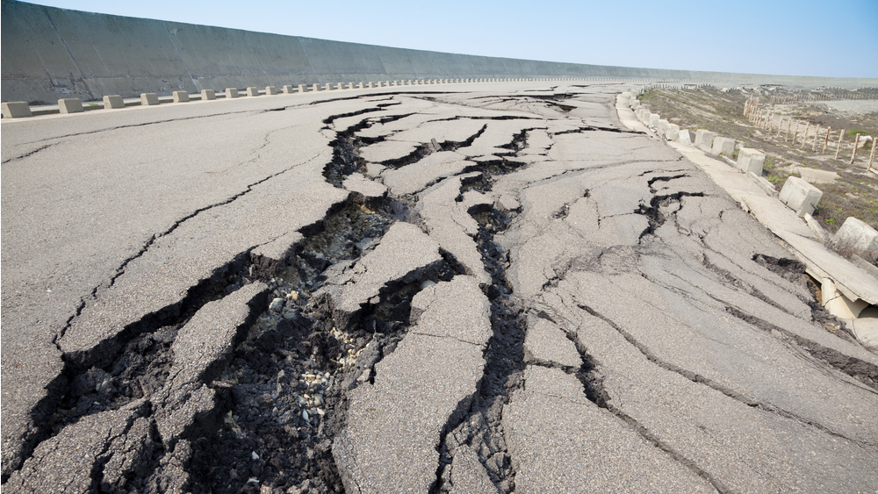
Earthquake and Evacuation
November 6, 2014

Slide 2
EQ and Evacuation Drill Friday, 11/14
The following slides will prepare you for an earthquake and the potential evacuation following it. We’ll be practicing this on Friday, 11/14, during Hawk Time.”

Slide 3
Earthquake P.A. Prompt
Shelter for earthquake. Drop, cover and hold. Shelter for earthquake. Drop, cover and hold.”

Slide 4
Drop, cover and hold for safety!
Hold on silently and wait for further instructions.

Slide 5
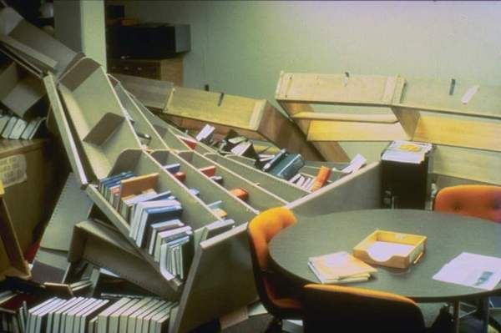
Evacuation
An earthquake may create unsafe conditions inside the school. Therefore we need to be prepared to evacuate.

Slide 6
Evacuation PA Prompt
Evacuate to the field. Evacuate to the field.”

Slide 7
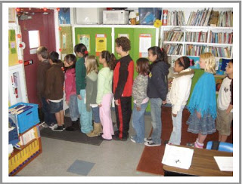
Instructions for Evacuation
Line up silently at the door and wait for your teacher.

Slide 8
Instructions for Evacuation
Follow your teacher silently to the field.

Slide 9
Instructions for Evacuation
Find your Hawk Time teacher alphabetically by last name, starting near the soccer goal closest to Hazelbrook Road.

Slide 10
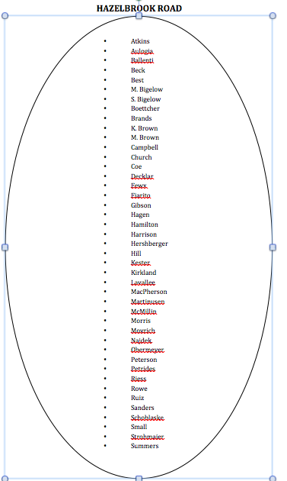
Evacuation Map

Slide 11
Instructions for Evacuation
Take roll, wait silently and use your communication card to indicate your situation to an administrator.

Slide 12
Instructions for Evacuation
If you’re asked over the PA system to “evacuate to the field” during passing time, walk out the nearest exit and locate your Hawk Time teacher on the field.

Slide 13
Review Questions
1. What should you do during and earthquake to protect yourself from injury?
2. If told to evacuate to the field, which teacher do you follow to the field? Who do you line up with on the field?
What are appropriate times to talk during an evacuation?

